Slide 1
Module 08
Insulation Coordination Part II

Slide 2
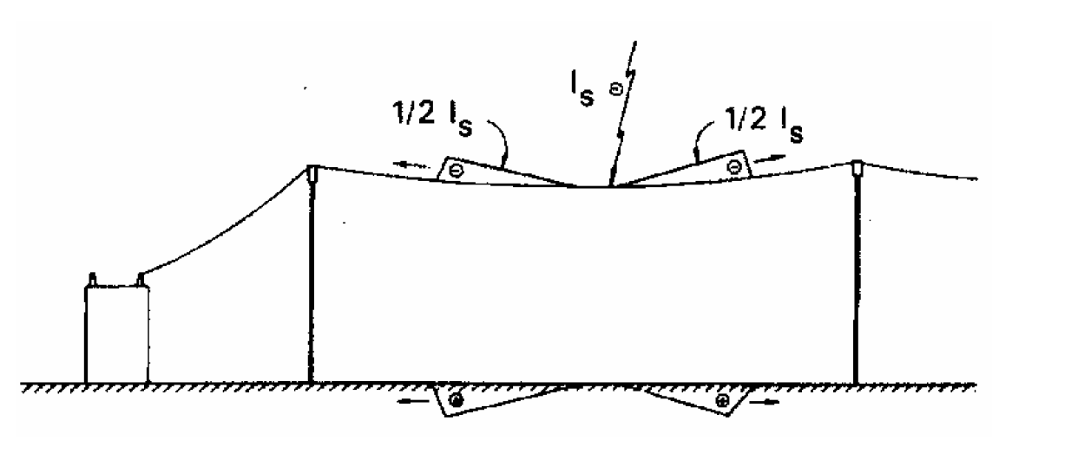
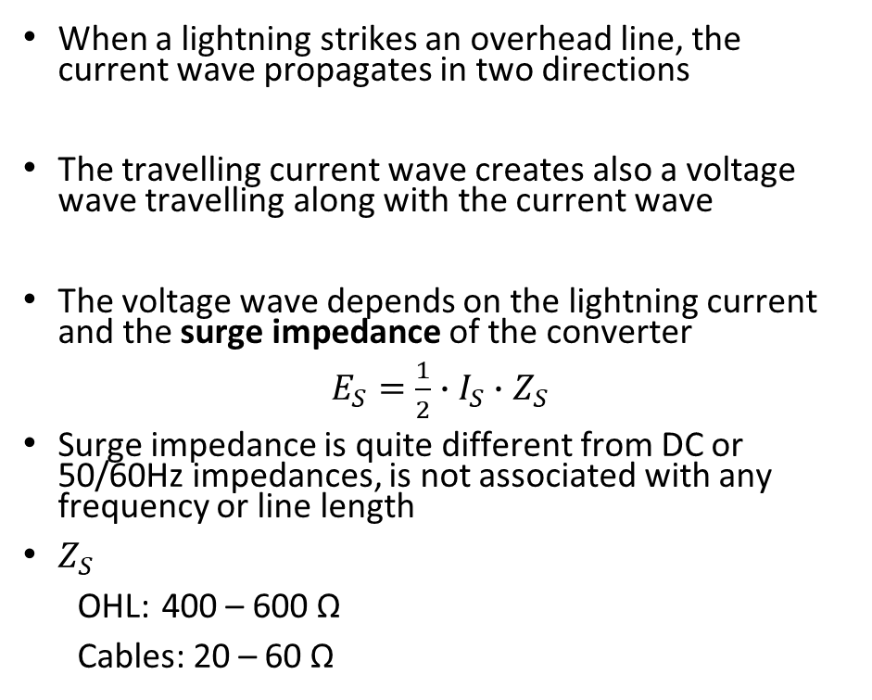
Lightning stroke
When a lightning strikes an overhead line, the current wave propagates in two directions
The travelling current wave creates also a voltage wave travelling along with the current wave
The voltage wave depends on the lightning current and the surge impedance of the converter
$E_{S}=\frac{1}{2}∙$ $I_{S}∙$ $Z_{S}$
Surge impedance is quite different from DC or 50/60Hz impedances, is not associated with any frequency or line length
$Z_{S}$
OHL: 400 – 600 Ω
Cables: 20 – 60 Ω
IEEE Std 998-1996

Slide 3
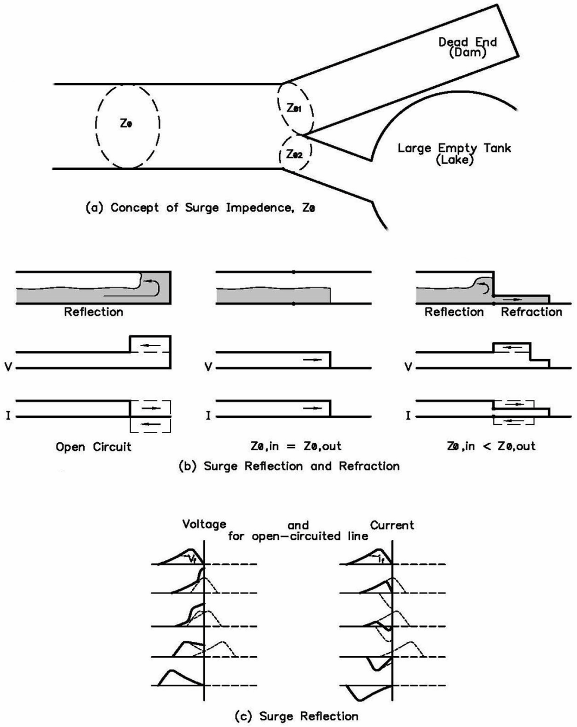
Lightning stroke
Travelling wave propagation is not comparable to the current flow at nominal frequency
If the conductor is an open circuit, no current will flow in the conductor, but the travelling wave can still enter the conductor
When the travelling wave hits the open circuit (e.g. transformer), the surge current will be reflected travel back with the opposite amplitude, the voltage keeps to polarity of the amplitude, but the amplitude is doubled
The increased aplitude at the transformers will need to be considered in the equipment design
Westinghouse Electric Corporation, “Electrical Transmission and Distribution Reference
Book”, published by Westinghouse Electric Corporation in 1961

Slide 4
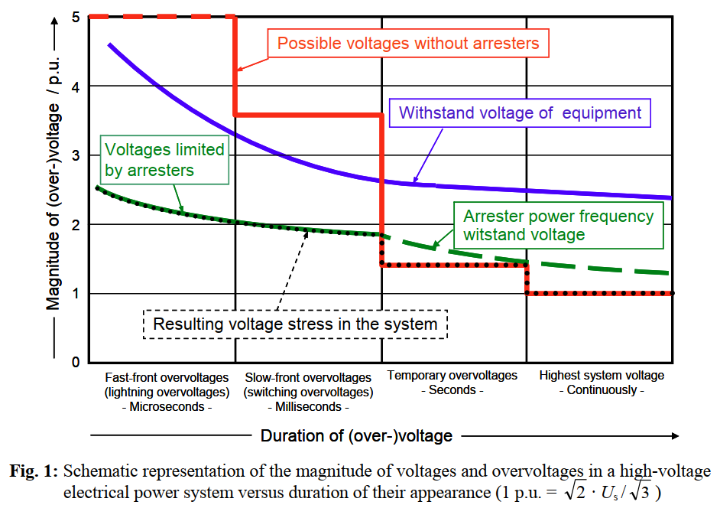
Overvoltages in AC grids
“Metal-Oxide Surge Arresters in High-Voltage Power Systems”, Volker Hinrichsen

Slide 5
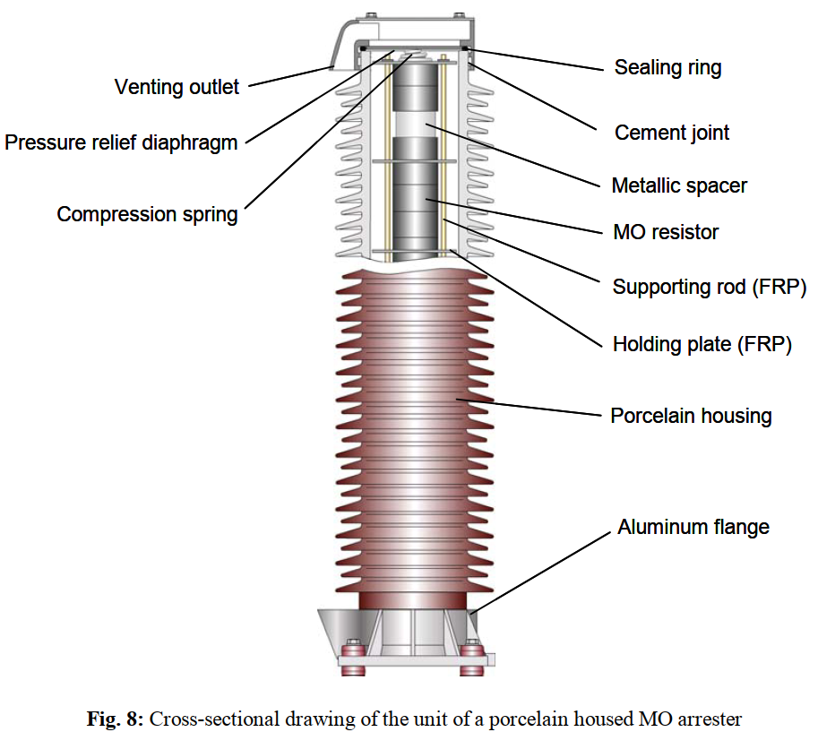
Arrester design
Arresters used today are metal-oxide (MO) arresters without gaps
Arresters are made up from MO resistor disks connected in series
Number of in series connected resistors define the characteristics of the arresters
MO resistors have extremely non-linear voltage-current or U-I-characteristic
Resistors are placed in a housing for protection against environmental conditions
“Metal-Oxide Surge Arresters in High-Voltage Power Systems”, Volker Hinrichsen

Slide 6
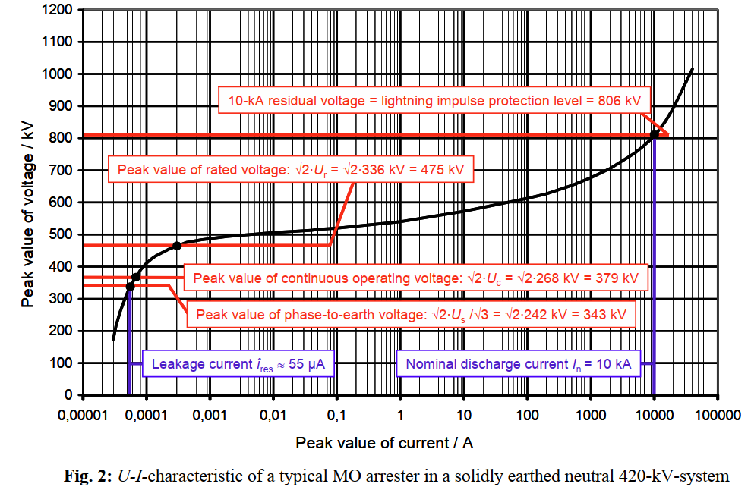
U-I arrester characteristic
U_{S}: Maximum System Voltage (phase-phase AC grid voltage)
U_{c}: Maximum Continuous Operating Voltage (MCOV)
For DC applications instead of MCOV, the crest value of continuous operating voltage (CCOV) is defined
Characteristics of the lightning impulse current (I_{n}) is 8/20 μs (fast-front/lightning)
Additionally switching impulse current 30/60 μs (slow-front/switching) is defined
“Metal-Oxide Surge Arresters in High-Voltage Power Systems”, Volker Hinrichsen

Slide 7
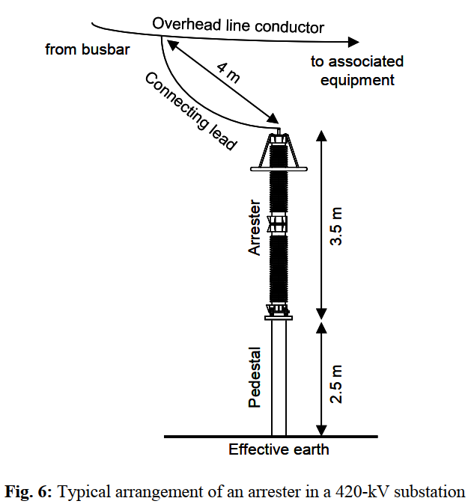
Impact on arrester protection capability – Arrester connection
Protection capability of the arrester is based on the capability to provide a low impedance path towards the earth
The impedance of the path is defined by the arrester itself and the connection of the arrester to the overhead line and to the earth
To consider that effects, either accurate calculations or safety margins are applied
“Metal-Oxide Surge Arresters in High-Voltage Power Systems”, Volker Hinrichsen

Slide 8
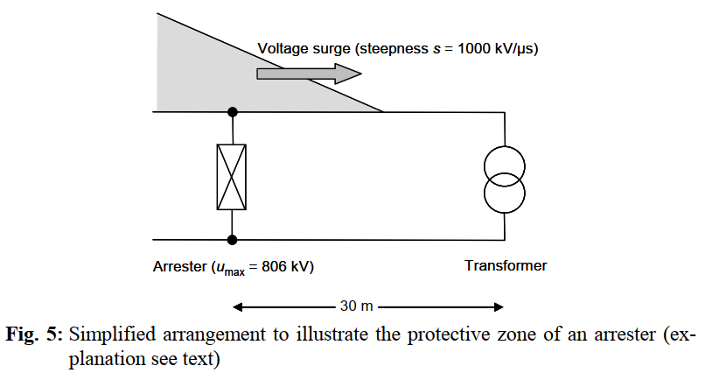
Impact on arrester protection capability – Travelling Wave
The surge current pulse will enter the also a “dead end” (e.g. transformer), that means even if the arrester is installed the travelling wave will enter the transformer connection and cause the voltage stress
The resulting voltage stress is therefore an overlap of the incoming voltage surge, reflecting of the voltage surge and the protection rating of the arrester
The voltage stress of the equipment is therefore not only defined by the protective level of the arrester but also by the distance between arrester and the device under protection
“Metal-Oxide Surge Arresters in High-Voltage Power Systems”, Volker Hinrichsen

Slide 9
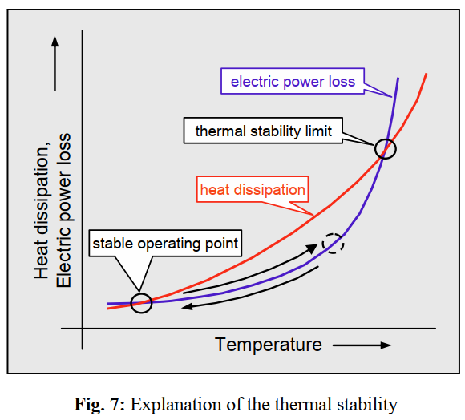
Energy handling capability
Simple impulse handling capability Energy that is injected in only a few µs must not cause any mechanical damage to the equipment
Thermal energy handling capability Maximum energy injected into the arrester during a transient event, at which it can still cool back down to its nominal operating temperature
The energy handling capability is not precisely defined in the standards, so that especially for VSC-HVDC systems, the energy loading of the arrester is an import point for design
“Metal-Oxide Surge Arresters in High-Voltage Power Systems”, Volker Hinrichsen

Slide 10
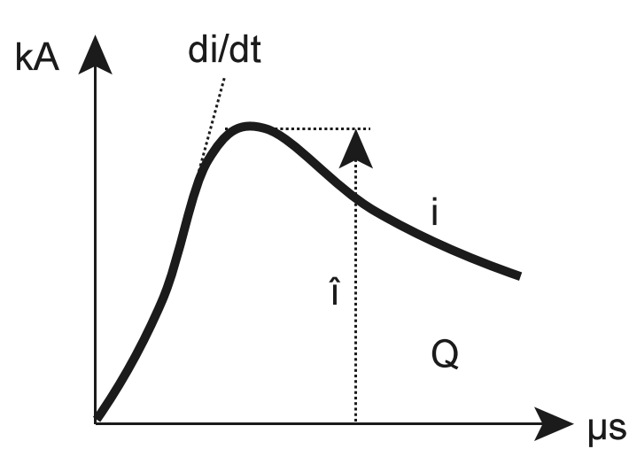
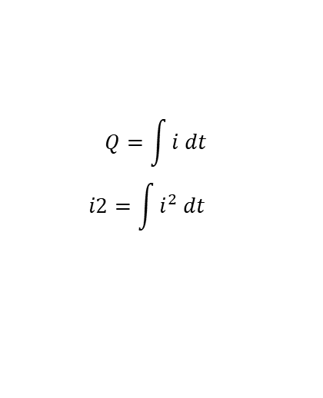
Lightning stroke energy
The energy of a lightning stroke is not only defined by the peak current but by the total capacitance Q of that lightning stroke
Assuming a ligthning stroke of 30kA and the surge impedance of the AC line of 600 Ω, the AC voltage travelling wave is: 9000 kV
Overvoltage on the conductors will cause a flashover on one or more line insulators because the insulators are not rated for that voltage, so that the biggest part of the charge is diverted through the flashover channels towards the ground before reaching equipment under protection
Most critical lightning strokes are therefore the ones hitting directly the substations, therefore a proper lightning protection of the equipment must be ensured
$$Q=\int{i dt}$$
$$i2=\int{i^{2} dt}$$

Slide 11
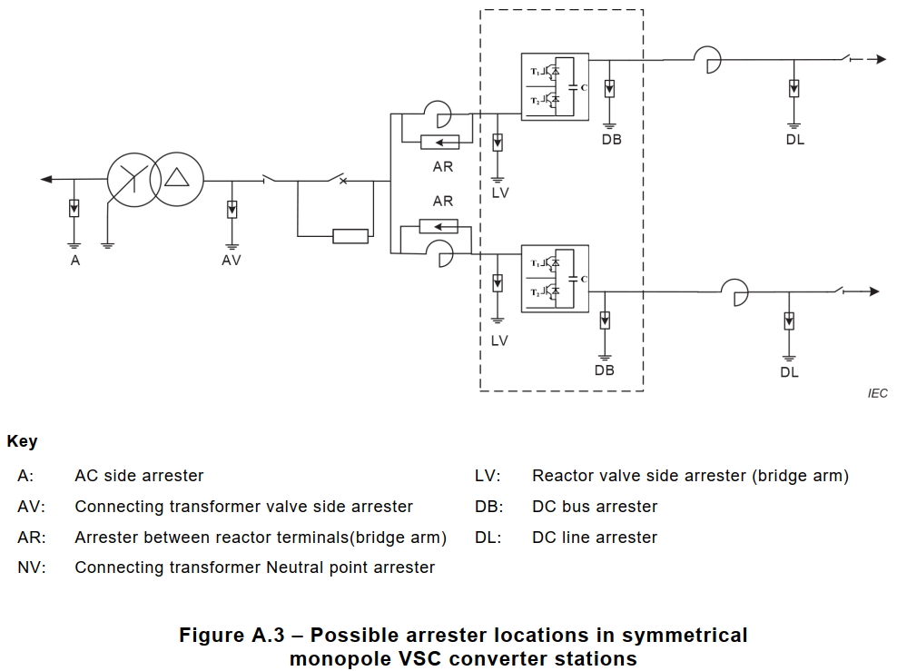
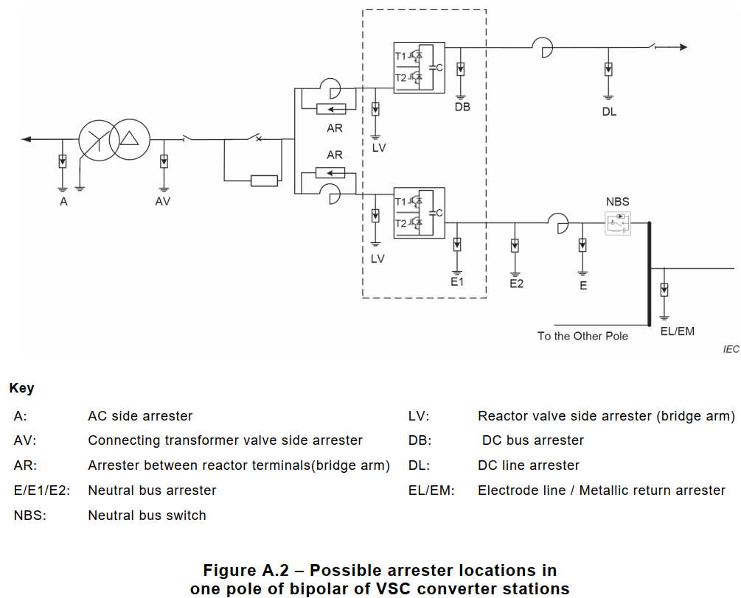
Arrester Configuration in VSC-HVDC systems
IEC 60071-11:2022

Slide 12
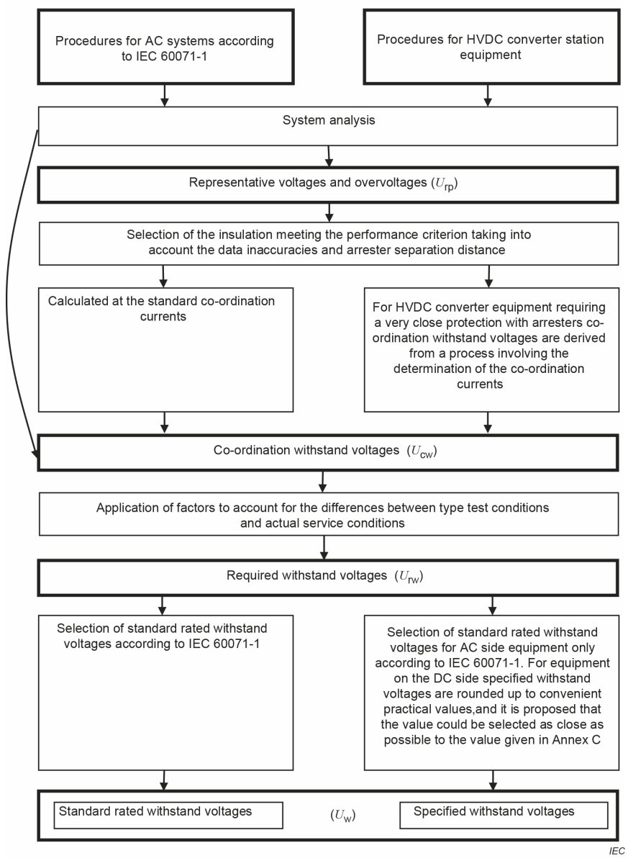
Withstand voltage definition process
Step 1: Determination of the representative overvoltages (U_{rp})
Step 2: Determination of the co-ordination withstand voltages (U_{cw}) For HVDC applications it can be assumed that U_{CW} = U_{rp}
Step 3: Determination of the required withstand voltages (U_{rw})
Step 4: Determination of the specified withstand voltages (U_{w})
IEC 60071-11:2022

Slide 13
Determination of the representative overvoltages (U_{rp})
“... that representative overvoltages are equal to protection levels of arresters for directly protected equipment.” IEC 60071-11:2022
The statement in the IEC is misleading since the protection level of arresters is defined by the arrester design and protection coordination current amplitude and shape (lightning, switching)
Representative overvoltages can be determined by:
Assuming maximum system currents and switching impulse
Analysis of relevant faults by transient simulations
The calculation and simulation results without any margin are considered as representative overvoltage U_{rp}

Slide 14
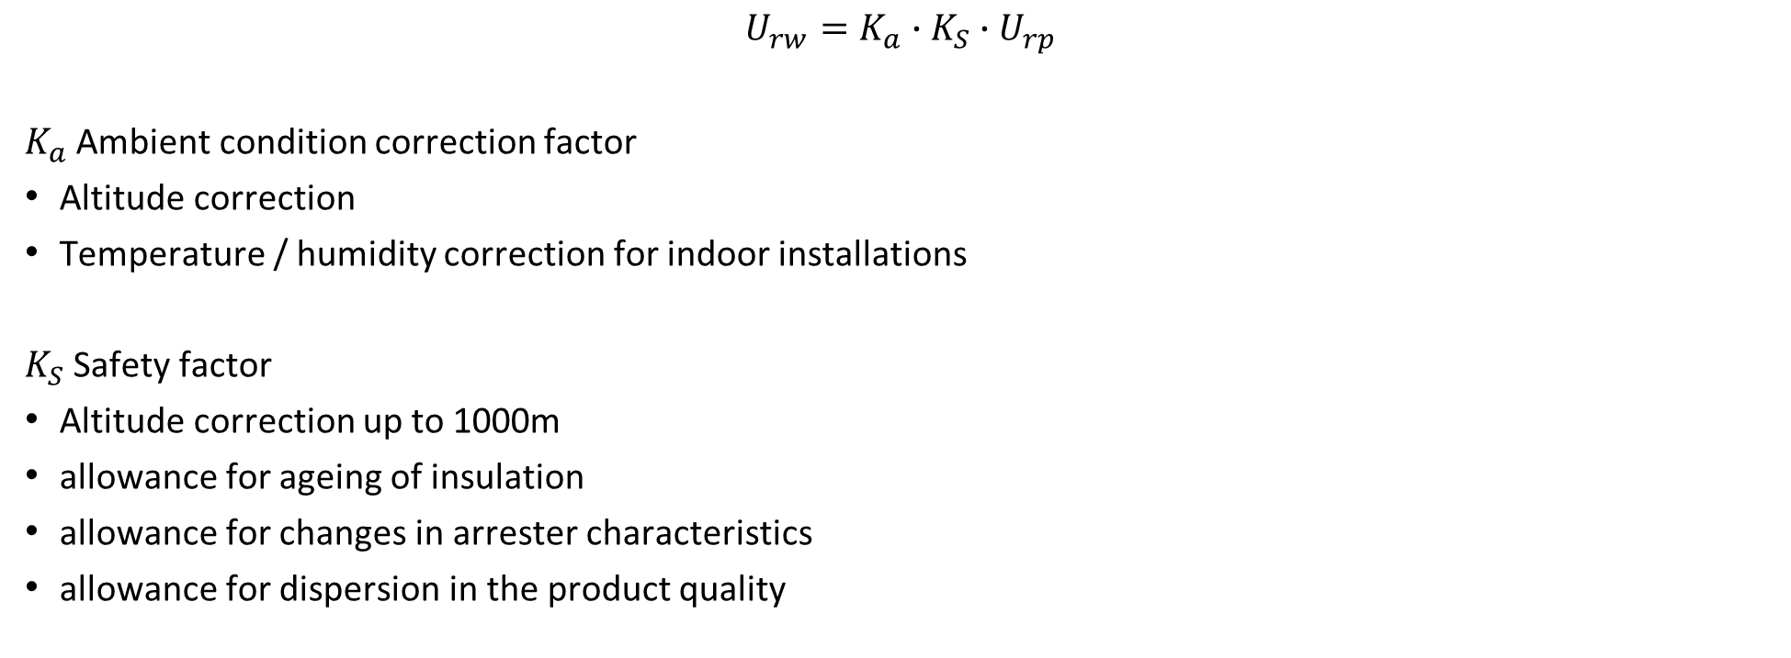
Determination of the required withstand voltages (U_{rw})
$$U_{rw}=K_{a}∙K_{S}∙U_{rp}$$
$K_{a}$ Ambient condition correction factor
Altitude correction
Temperature / humidity correction for indoor installations
$K_{S}$ Safety factor
Altitude correction up to 1000m
allowance for ageing of insulation
allowance for changes in arrester characteristics
allowance for dispersion in the product quality

Slide 15
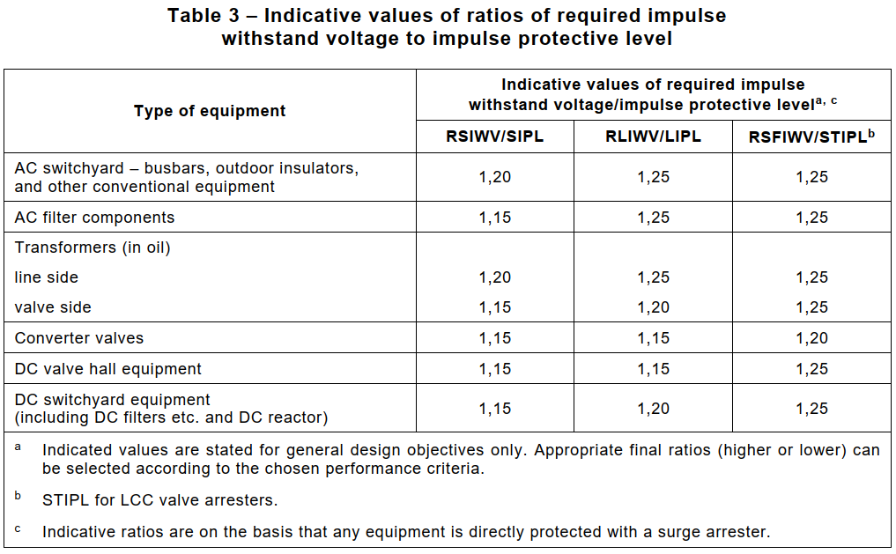

Determination of the required withstand voltages (U_{rw})
$K_{S}$ Safety factor
IEC 60071-11:2022

Slide 16
Determination of the specified withstand voltages (U_{w})
Values are equal to or higher than the U_{rw}
For AC equipment, the specified withstand voltages correspond to standard values as stated in IEC 60071-1.
For HVDC equipment, the specified withstand voltages are rounded up to convenient values (in most cases it is IEC 60071-1)
Proposed values are:
U_{w} / kV | U_{w} / kV
550 | 1300
650 | 1425
750 | 1550
850 | 1675
950 | 1800
1050 | 1950
1175

Slide 17
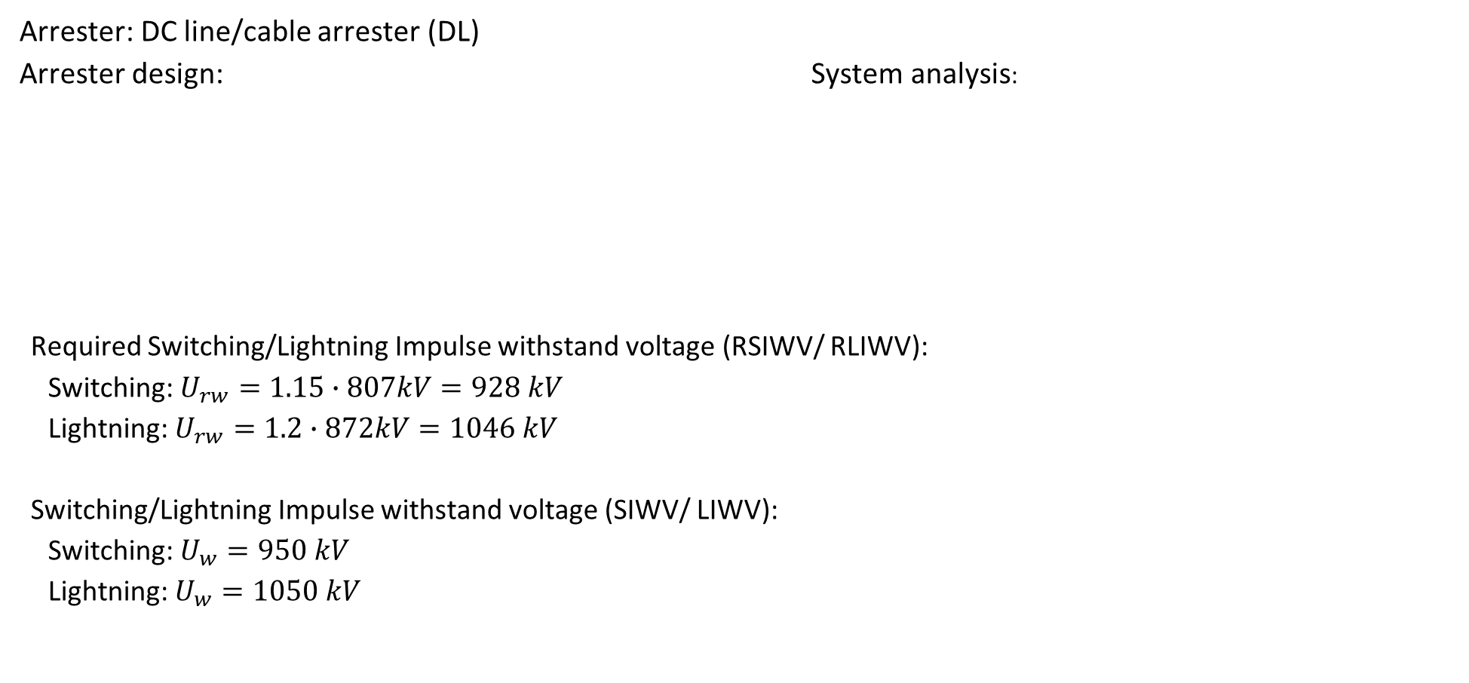
Example for insulation point coordination
Arrester: DC line/cable arrester (DL)
Arrester design: System analysis:
Required Switching/Lightning Impulse withstand voltage (RSIWV/ RLIWV):
Switching: $U_{rw}=1.15∙807kV=928 kV$
Lightning: $U_{rw}=1.2∙872kV=1046 kV$
Switching/Lightning Impulse withstand voltage (SIWV/ LIWV):
Switching: $U_{w}=950 kV$
Lightning: $U_{w}=1050 kV$
Parameter | Value
CCOV | 515 kV
Number of parallel columns | 8
Energy capability | 17 MJ
Parameter | Value
SIPL (U_{rp} for SI) | 807 kV @ 1 kA
LIPL (U_{rp} for LI) | 872 kV @ 5 kA

